Slide 1
DNA PATTERN MATCHING USING STRING SEARCHING ALGORITHMS
- Kasturi Vartak

Slide 2
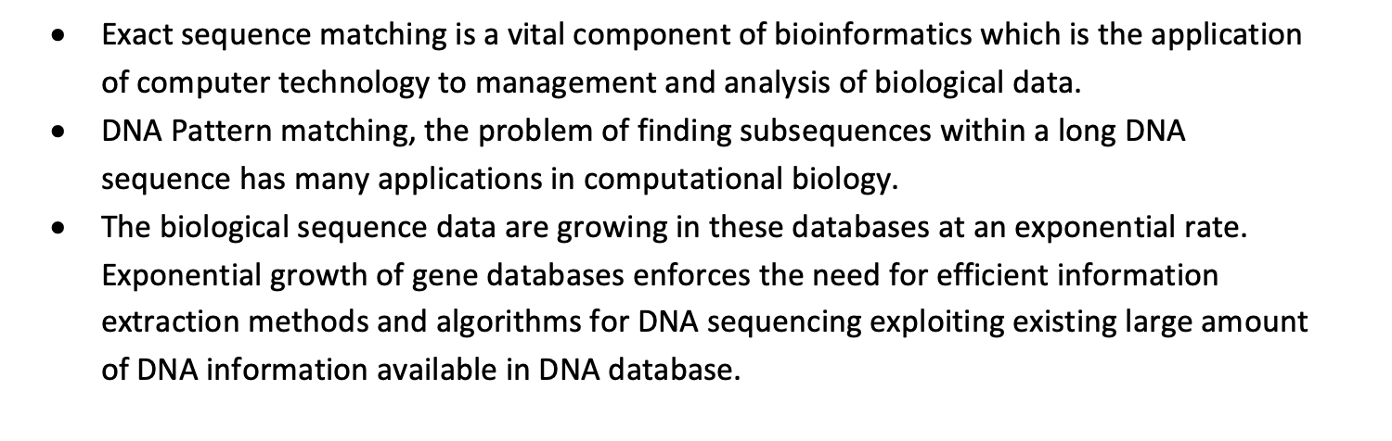

Slide 3
Following algorithms are implemented in this project:
Knuth-Morris-Patt (KMP)
Boyer-Moore

Slide 4
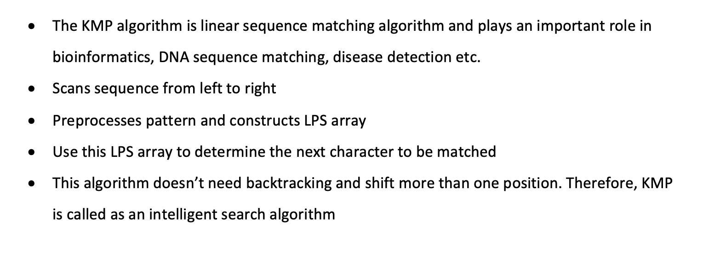
KMP

Slide 5
Preprocessing
Creating LPS array
Consider following pattern:
A
T
A
Length of LPS array equals to length of pattern which is 3
LPS
0
1
2

Slide 6
Step 1:
﻿def fun_lps(DNA_pattern_list,lps):
i=0
j=1
while(j < DNA_pattern_LEN):
if(DNA_pattern_list[i] != DNA_pattern_list[j]):
if(i==0):
lps[j]=0
j=j+1
else:
i=lps[i-1]
else:
lps[j]=i+1
i=i+1
j=j+1
Define i=0, j=1 and LPS[0]=0
LPS
0
i=0 j=1
0
1
2

Slide 7
Step 2:
Compare pattern[i] with pattern[j] → A with T
Since both are not matching and i=0, we need to set LPS[j]=0 and increment j by 1
﻿def fun_lps(DNA_pattern_list,lps):
i=0
j=1
while(j < DNA_pattern_LEN):
if(DNA_pattern_list[i] !=DNA_pattern_list[j]):
if(i==0):
lps[j]=0
j=j+1
else:
i=lps[i-1]
else:
lps[j]=i+1
i=i+1
j=j+1
LPS
0
0
i=0 j=2
0
1
2

Slide 8
Step 3:
﻿def fun_lps(DNA_pattern_list,lps):
i=0
j=1
while(j < DNA_pattern_LEN):
if(DNA_pattern_list[i] != DNA_pattern_list[j]):
if(i==0):
lps[j]=0
j=j+1
else:
i=lps[i-1]
else:
lps[j]=i+1
i=i+1
j=j+1
Compare pattern[i] with pattern[j] → A with A
Since both are equal, we need to set LPS[j]=i+1(which is 1)
and increment I and j by 1
LPS
i=1 j=3
0
0
1
0
1
2

Slide 9
Step 4:
As LPS is filled with values we stop the process.
The final LPS array is
def fun_lps(DNA_pattern_list,lps):
i=0
j=1
while(j < DNA_pattern_LEN):
if(DNA_pattern_list[i] != DNA_pattern_list[j]):
if(i==0):
lps[j]=0
j=j+1
else:
i=lps[i-1]
else:
lps[j]=i+1
i=i+1
j=j+1
LPS
0
0
1
0
1
2

Slide 10
Searching Pattern
Consider following text:
A
T
G
C
A
T
A

Slide 11
Start comparing first character of Pattern to first character of Text
﻿i=0
j=0
while(i < DNA_seq_LEN):
if(DNA_seq_list[i]==DNA_pattern_list[j]):
i=i+1
j=j+1
if(j==DNA_pattern_LEN):
print("Pattern Found at Index : "+str(i-j))
j=lps[j-1]
elif(i<DNA_seq_LEN and DNA_seq_list[i]!=DNA_pattern_list[j]):
if(j==0):
i=i+1
elif(j!=0):
j=lps[j-1]
A
T
G
C
A
T
A
0
1
2
3
4
5
6
A
T
A
0
1
2

Slide 12
Start comparing first character of Pattern to first character of Text
﻿i=0
j=0
while(i < DNA_seq_LEN):
if(DNA_seq_list[i]==DNA_pattern_list[j]):
i=i+1
j=j+1
if(j==DNA_pattern_LEN):
print("Pattern Found at Index : "+str(i-j))
j=lps[j-1]
elif(i<DNA_seq_LEN and DNA_seq_list[i]!=DNA_pattern_list[j]):
if(j==0):
i=i+1
elif(j!=0):
j=lps[j-1]
A
T
G
C
A
T
A
0
1
2
3
4
5
6
A
T
A
0
1
2
Here mismatch occurred at pattern[2]so we need to consider LPS[1] value. Since LPS[1] is 0, we compare first character in pattern with next character in Text

Slide 13
compare first character in pattern with next character in Text
﻿i=0
j=0
while(i < DNA_seq_LEN):
if(DNA_seq_list[i]==DNA_pattern_list[j]):
i=i+1
j=j+1
if(j==DNA_pattern_LEN):
print("Pattern Found at Index : "+str(i-j))
j=lps[j-1]
elif(i<DNA_seq_LEN and DNA_seq_list[i]!=DNA_pattern_list[j]):
if(j==0):
i=i+1
elif(j!=0):
j=lps[j-1]
A
T
G
C
A
T
A
0
1
2
3
4
5
6
A
T
A
0
1
2
i=3 j=0

Slide 14
compare first character in pattern with next character in Text
﻿i=0
j=0
while(i < DNA_seq_LEN):
if(DNA_seq_list[i]==DNA_pattern_list[j]):
i=i+1
j=j+1
if(j==DNA_pattern_LEN):
print("Pattern Found at Index : "+str(i-j))
j=lps[j-1]
elif(i<DNA_seq_LEN and DNA_seq_list[i]!=DNA_pattern_list[j]):
if(j==0):
i=i+1
elif(j!=0):
j=lps[j-1]
A
T
G
C
A
T
A
0
1
2
3
4
5
6
A
T
A
0
1
2
i=4 j=0

Slide 15
compare first character in pattern with next character in Text
﻿i=0
j=0
while(i < DNA_seq_LEN):
if(DNA_seq_list[i]==DNA_pattern_list[j]):
i=i+1
j=j+1
if(j==DNA_pattern_LEN):
print("Pattern Found at Index : "+str(i-j))
j=lps[j-1]
elif(i<DNA_seq_LEN and DNA_seq_list[i]!=DNA_pattern_list[j]):
if(j==0):
i=i+1
elif(j!=0):
j=lps[j-1]
A
T
G
C
A
T
A
0
1
2
3
4
5
6
A
T
A
0
1
2

Slide 16
compare first character in pattern with next character in Text
﻿i=0
j=0
while(i < DNA_seq_LEN):
if(DNA_seq_list[i]==DNA_pattern_list[j]):
i=i+1
j=j+1
if(j==DNA_pattern_LEN):
print("Pattern Found at Index : "+str(i-j))
j=lps[j-1]
elif(i<DNA_seq_LEN and DNA_seq_list[i]!=DNA_pattern_list[j]):
if(j==0):
i=i+1
elif(j!=0):
j=lps[j-1]
A
T
G
C
A
T
A
0
1
2
3
4
5
6
A
T
A
0
1
2
When j equals to length of the pattern that is 3, we have found the pattern at position i

Slide 17
At this point I is not less than lenth if text
Thus we terminate
﻿i=0
j=0
while(i < DNA_seq_LEN):
if(DNA_seq_list[i]==DNA_pattern_list[j]):
i=i+1
j=j+1
if(j==DNA_pattern_LEN):
print("Pattern Found at Index : "+str(i-j))
j=lps[j-1]
elif(i<DNA_seq_LEN and DNA_seq_list[i]!=DNA_pattern_list[j]):
if(j==0):
i=i+1
elif(j!=0):
j=lps[j-1]
A
T
G
C
A
T
A
0
1
2
3
4
5
6
A
T
A
0
1
2

Slide 18
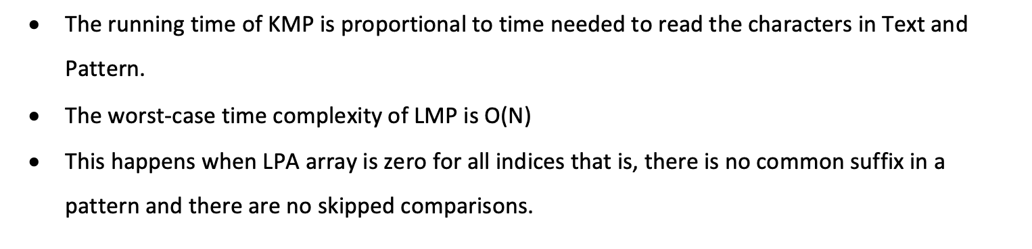
Analysis

Slide 19
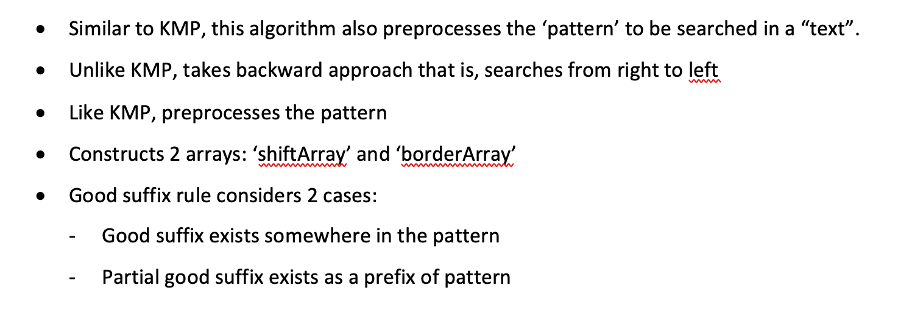
Boyer-Moore

Slide 20
Let’s consider two use cases for preprocessing

Slide 21
Case 1: Good suffix exists somewhere in the pattern
Current location
in text
Meet
mismatch
{
Good suffix
The green part is ‘Good suffix’
A mismatch meaning current location is not suitable starting place for following pattern
We need to find next possible location where the pattern should be shifted to
Unlike naïve matching pattern (Brute-force algorithm) where we just shift the pattern by 1 character,
which does not make use of good suffix that exist in both Text and Pattern

Slide 22
In this case, shift the pattern so that green part is aligned
?

Slide 23
In this case, shift the pattern so that green part is aligned
?

Slide 24
In this case, shift the pattern so that green part is aligned
And check if the pattern align with the text in the new location

Slide 25
We don’t want to shift the new green area with the same character as current good suffix
Because it is already known that red character is a mismatch with the yellow one
mismatch

Slide 26
We don’t want to shift the new green area with the same character as current good suffix
Because it is already known that red character is a mismatch with the yellow one
mismatch

Slide 27
mismatch
Can’t find a matched good suffix in the pattern somewhere else

Slide 28
Case 2: Partial good suffix exist as a prefix of pattern
mismatch
Can’t find a matched good suffix in the pattern somewhere else
However ‘suffix of suffix’(blue part) can be found prefix of the pattern

Slide 29
Can’t find a matched good suffix in the pattern somewhere else
However ‘suffix of suffix’(blue part) can be found prefix of the pattern

Slide 30
In this case, we shift the pattern so that partial suffix will align with prefix of the pattern

Slide 31
{
Virtual
Good suffix
We can add virtual green part to the partial good suffix(blue part) to make it a virtual complete good suffix
starting at the location before the pattern

Slide 32
Let us consider same example and apply Boyer-Moore algorithm
Pattern
A
T
A
0
1
2
Text
A
T
G
C
A
T
A
0
1
2
3
4
5
6

Slide 33
﻿def fullSuffixMatch_case1(shiftArray, borderArray, DNA_pattern, patLen):
i = patLen
j = patLen + 1
borderArray[i] = j
while(i > 0):
while ((j <= patLen) and (DNA_pattern[i - 1] != DNA_pattern[j - 1])):
if(shiftArray[j]==0):
shiftArray[j] = j - i
j = borderArray[j]
i = i- 1
j =j-1
borderArray[i] = j
﻿def fullSuffixMatch_case2(shiftArray, borderArray, DNA_pattern, patLen):
j=borderArray[0]
for i in range(patLen+1):
if(shiftArray[i]==0):
shiftArray[i]=j
if(i==j):
j=borderArray[j]

Slide 34
We need to construct 2 arrays viz.
﻿borderArray and ﻿shiftArray
to know how many characters we need
to shift when mismatch occurs
Create 2 arrays and initialize them to 0
borderArray
0
0
0
0
﻿borderArray = [0] * (patLen + 1)
shiftArray = [0] * (patLen + 1)
0
1
2
3
shiftArray
0
0
0
0
0
1
2
3

Slide 35
We have 2 arrays constructed
Now lets search pattern according to these arrays
borderArray
2
3
3
4
0
1
2
3
shiftArray
2
2
2
1
0
1
2
3

Slide 36
Compare characters from right to left
﻿while(i <= DNALen - patLen):
j=patLen -1
while(j>=0 and DNA_pattern[j] == DNA_seq[i+j]):
j=j-1
if(j<0):
print("\npattern found at position : ",i)
i = i +shiftArray[0]
else:
i = i + shiftArray[j+1]
Text
A
T
G
C
A
T
A
0
1
2
3
4
5
6
Pattern
A
T
A
0
1
2
As mismatch occurs, we use shiftArray constructed
to decide by how many characters we shift the pattern

Slide 37
Text
A
T
G
C
A
T
A
﻿while(i <= DNALen - patLen):
j=patLen -1
while(j>=0 and DNA_pattern[j] == DNA_seq[i+j]):
j=j-1
if(j<0):
print("\npattern found at position : ",i)
i = i +shiftArray[0]
else:
i = i + shiftArray[j+1]
0
1
2
3
4
5
6
Pattern
A
T
A
0
1
2

Slide 38
Text
A
T
G
C
A
T
A
﻿while(i <= DNALen - patLen):
j=patLen -1
while(j>=0 and DNA_pattern[j] == DNA_seq[i+j]):
j=j-1
if(j<0):
print("\npattern found at position : ",i)
i = i +shiftArray[0]
else:
i = i + shiftArray[j+1]
0
1
2
3
4
5
6
Pattern
A
T
A
0
1
2
Keep comparing until mismatch

Slide 39
Text
A
T
G
C
A
T
A
﻿while(i <= DNALen - patLen):
j=patLen -1
while(j>=0 and DNA_pattern[j] == DNA_seq[i+j]):
j=j-1
if(j<0):
print("\npattern found at position : ",i)
i = i +shiftArray[0]
else:
i = i + shiftArray[j+1]
0
1
2
3
4
5
6
Pattern
A
T
A
0
1
2
Mismatch at Pattern[1]

Slide 40
﻿while(i <= DNALen - patLen):
j=patLen -1
while(j>=0 and DNA_pattern[j] == DNA_seq[i+j]):
j=j-1
if(j<0):
print("\npattern found at position : ",i)
i = i +shiftArray[0]
else:
i = i + shiftArray[j+1]
Text
A
T
G
C
A
T
A
0
1
2
3
4
5
6
Pattern
A
T
A
0
1
2
From constructed shiftArray we can see that we are able to skip positions
unlike naïve matching pattern (Brute-force algorithm) where we just shift the pattern by 1 character.
Now we have a matching pattern at position i

Slide 41
Constructing borderArray and shiftArray takes O(n) time complexity
Where n → length of pattern
When pattern does not appear in the Text, worst case time complexity is O(m+n)
When pattern does appear in the Text, worst case time complexity is O(mn)

Slide 42
To measure the performance, we have taken Human genome and search number of occurrences of diseased DNA (Lamda virus)

Slide 43
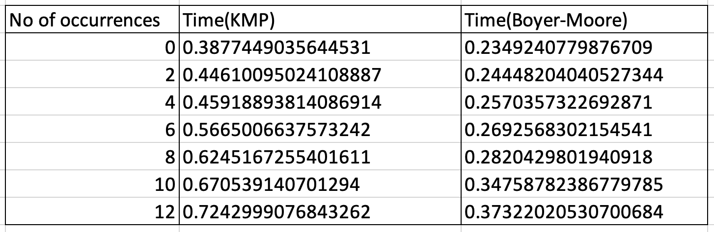

Slide 44
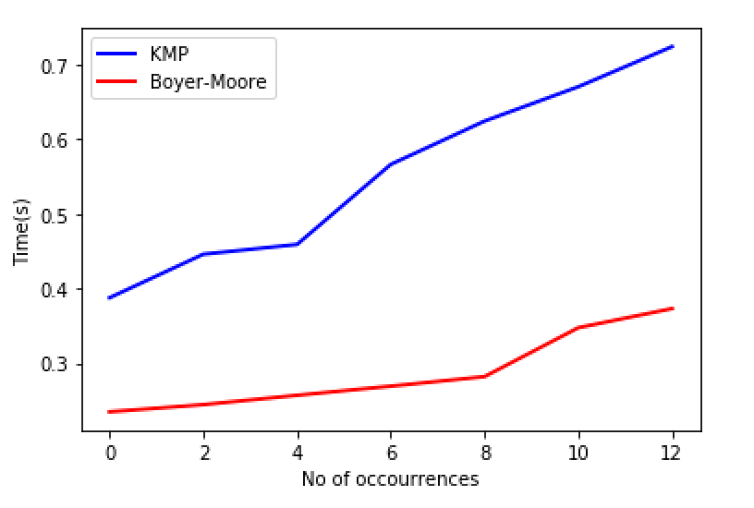

Slide 45
References:
[1] http://www.btechsmartclass.com/data_structures/knuth-morris-pratt-algorithm.html
[2] https://www.inf.hs-flensburg.de/lang/algorithmen/pattern/bmen.htm
[3] https://d28rh4a8wq0iu5.cloudfront.net/ads1/data/lambda_virus.fa
[4] http://useast.ensembl.org/Homo_sapiens/Info/Index

